Slide 1
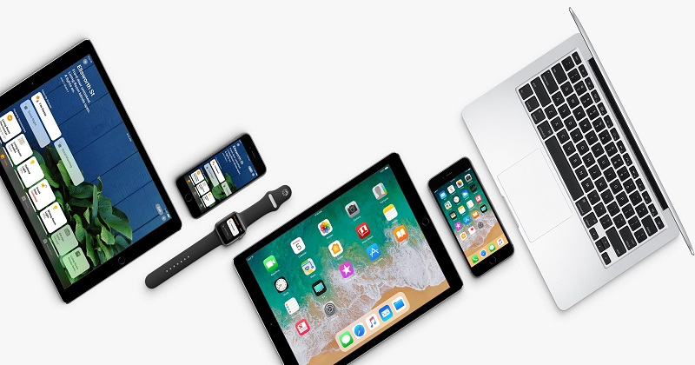

INTRODUCING TO IOS

Slide 2
Contents
Introducing to iOS
Environment development
Demo
Pros and Cons
1
2
3
4

Slide 3

iOS
Introducing to iOS
1.
- is a mobile operating system created and developed by Apple.
- use in iPhone, iPad, and Apple Watch
- The current stable version, iOS 14, was released to the public on September 16, 2020.

Slide 4
Milestones
6/2007
9/2007
1/2010
3/2018
Now
Introducing to iOS
1.
9/6/2007: iPhone
9/2007: iPod Touch
1/2010:
iPad
3/2018:
2,1 millions applications were uploaded to Apple Store
2018:
130 billions downloads

Slide 5
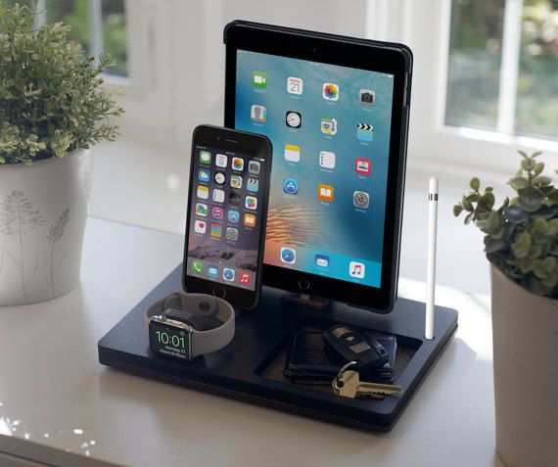
Devices run iOS
Introducing to iOS
1.

Slide 6
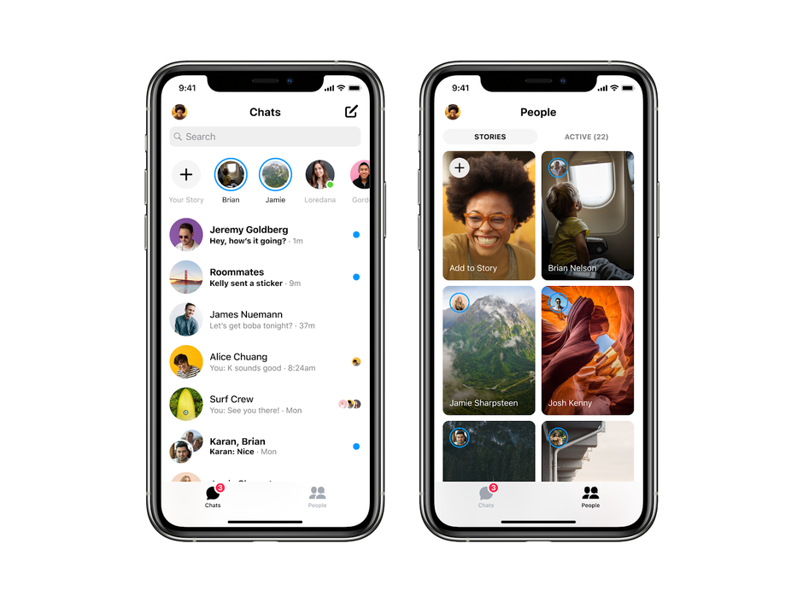
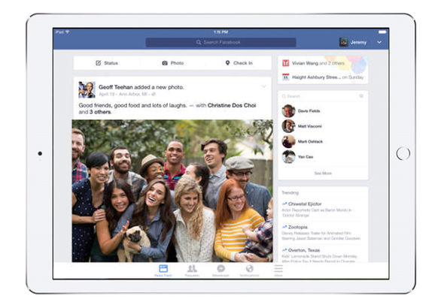
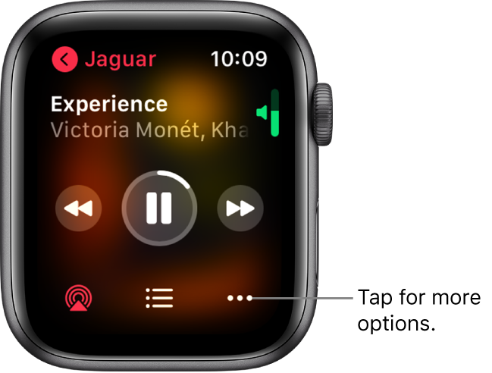
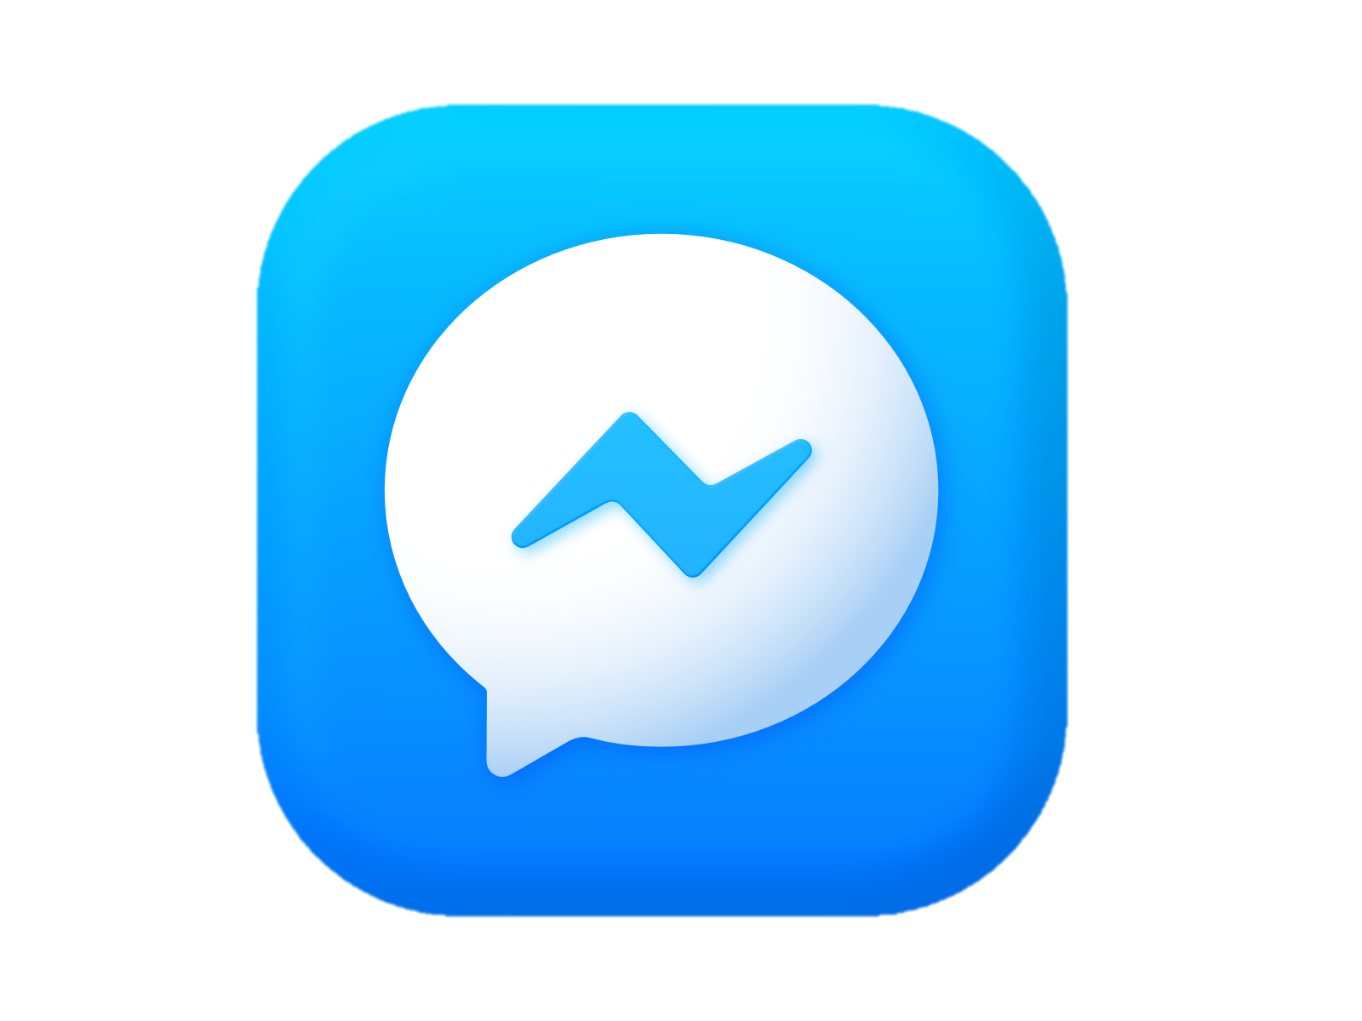

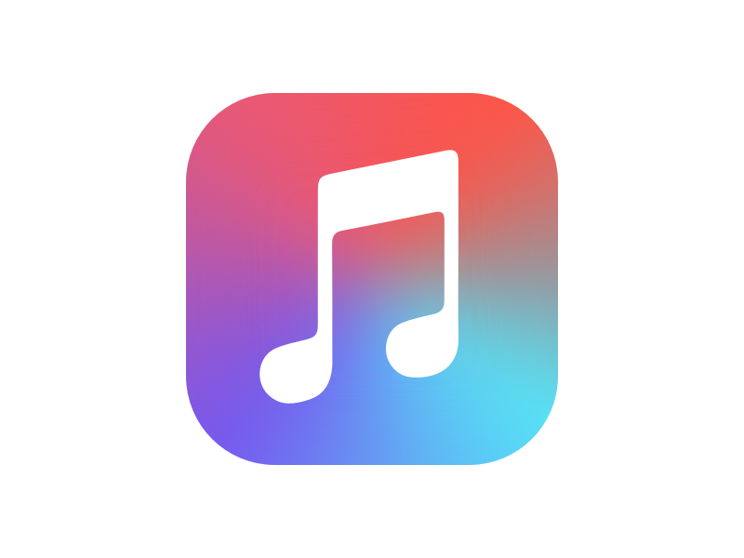
Applications
Introducing to iOS
1.

Slide 7
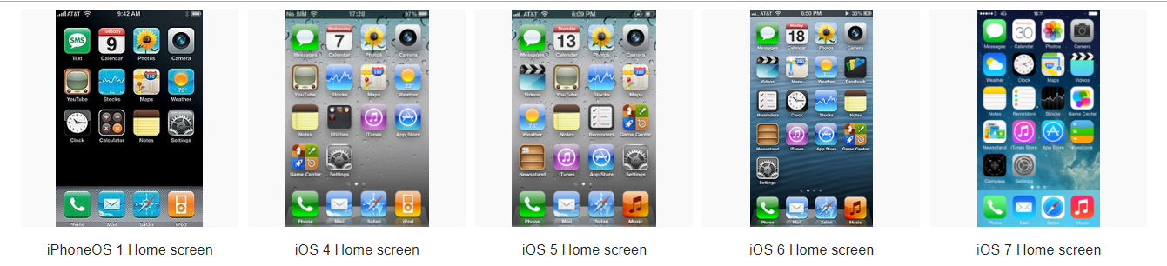
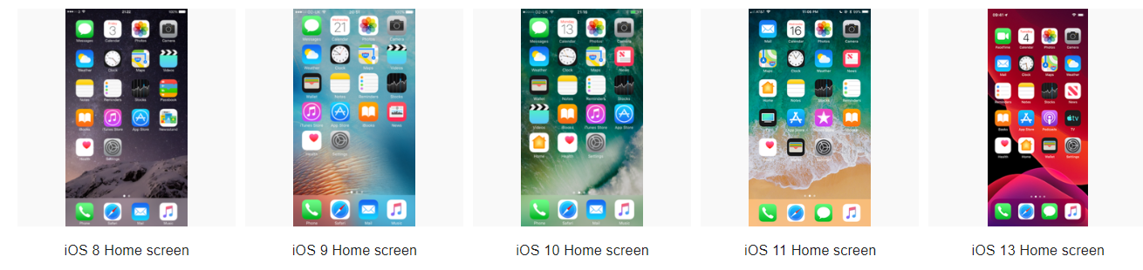
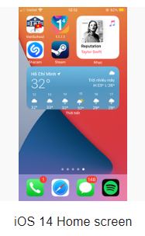
iOS versions
Introducing to iOS
1.

Slide 8
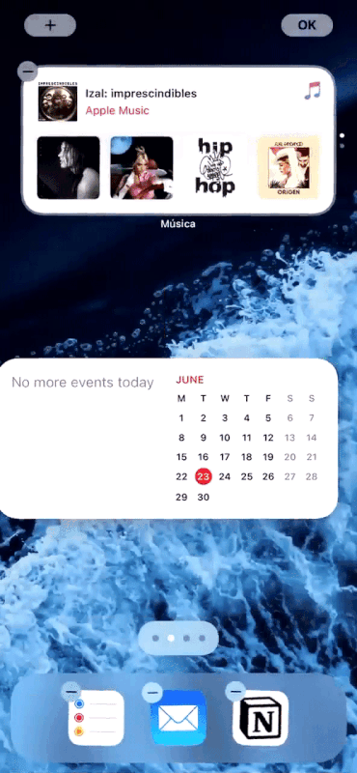
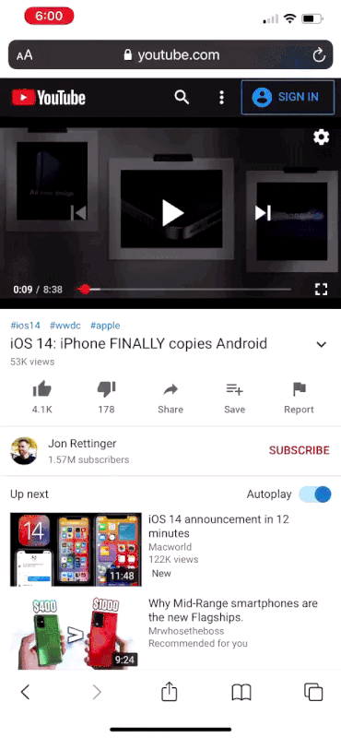
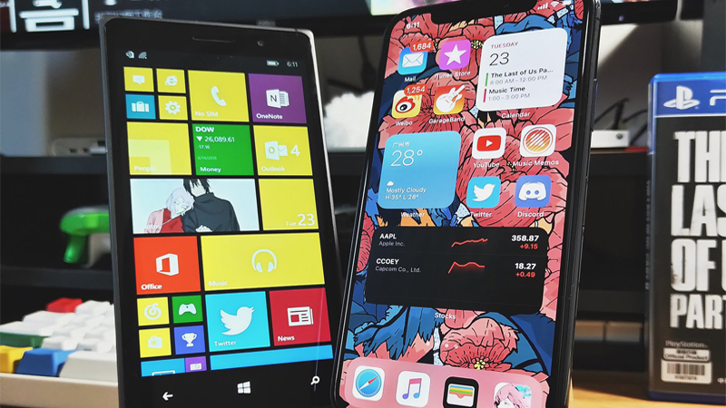
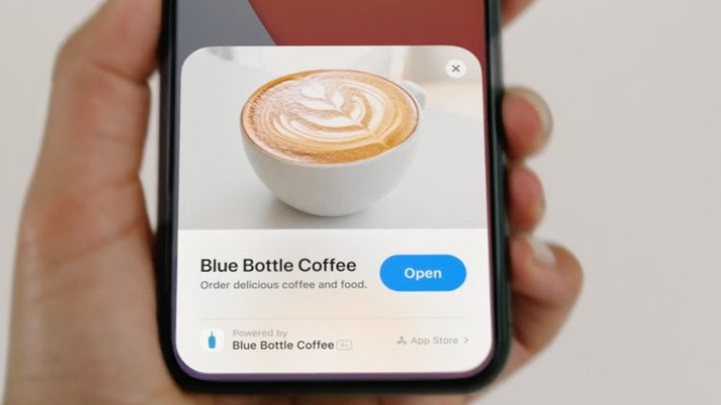
New features
Introducing to iOS
1.
App Library
Widgets
Picture in picture
App Clips

Slide 9
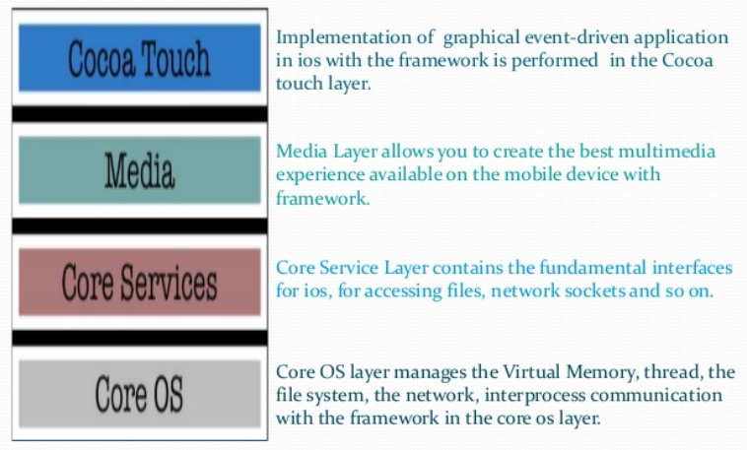
Introducing to iOS
1.
IOS ARCHITECTURE

Slide 10

2. Pros and Cons
Pros
High profits
Stable and completed ecosystem
Best quality application
Popularity

Slide 11

2. Pros and Cons
Cons
Expensive developing devices
The development environment is of high difficulty.
- Difficult to publish app

Slide 12
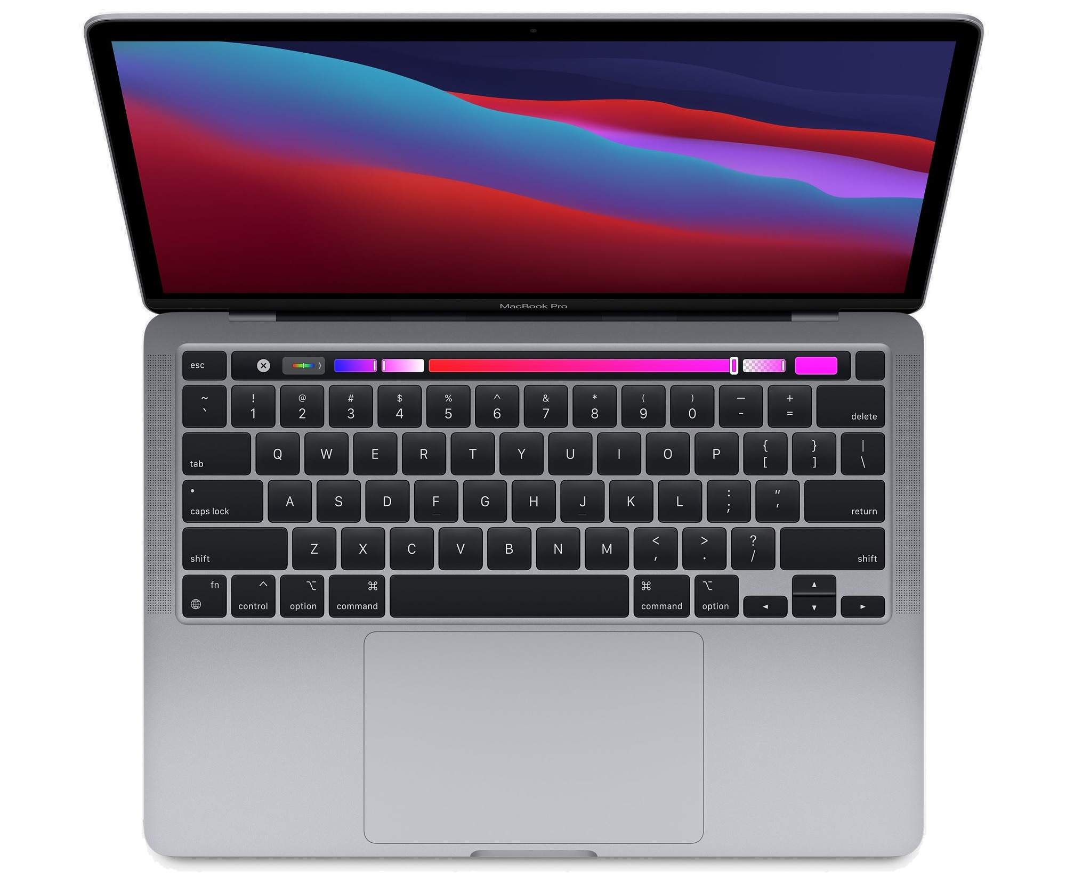
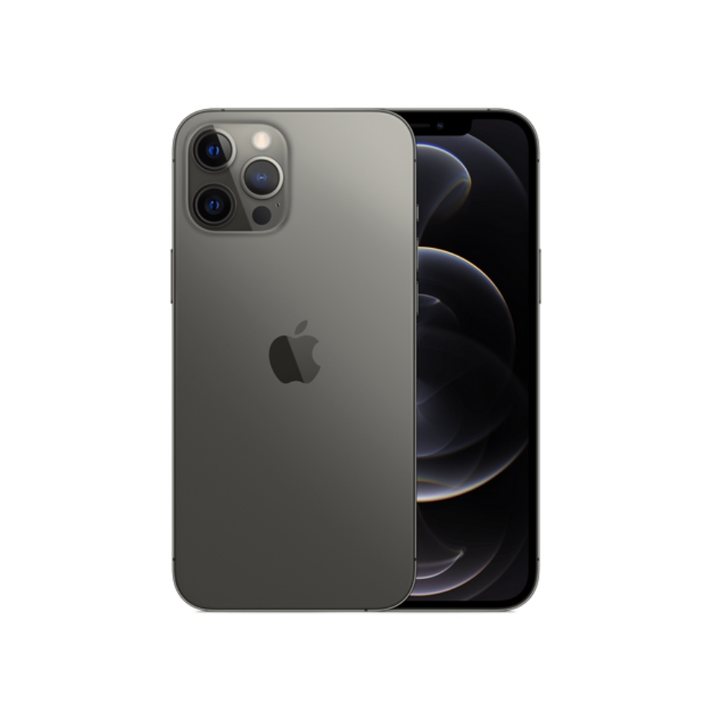
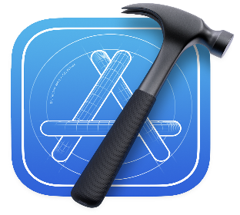
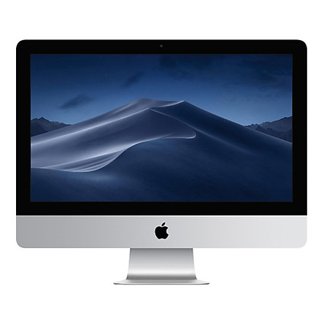
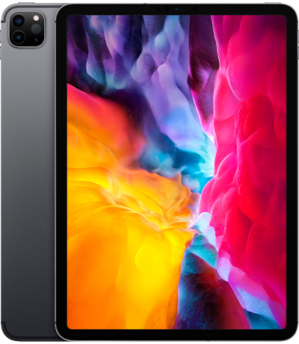

3. Environment development
Apple developer account

Slide 13
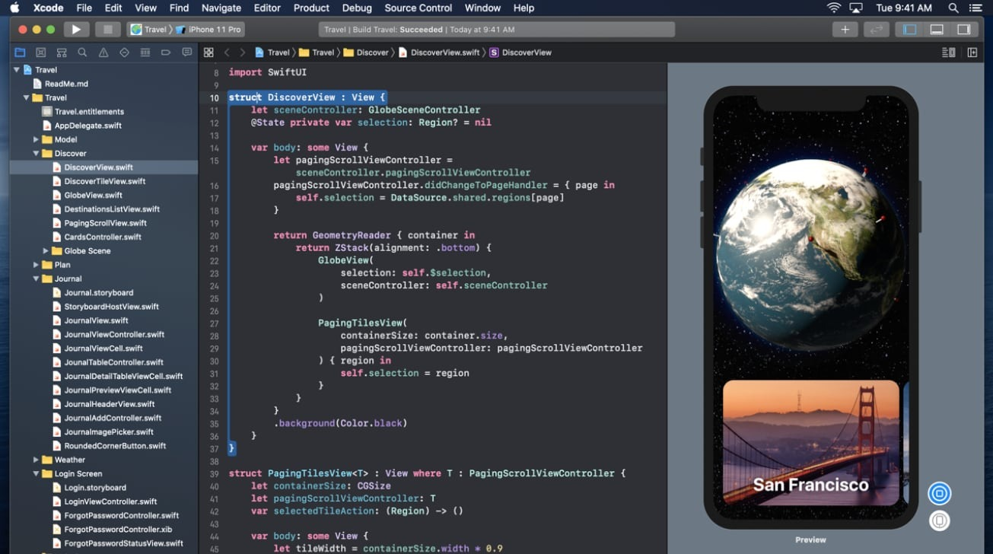
3. Environment development
Xcode
- IDE to develop macOS, iOS,….
- contain a suite of software development tools developed by Apple
- Now version: 12.3 – 14/12/20

Slide 14
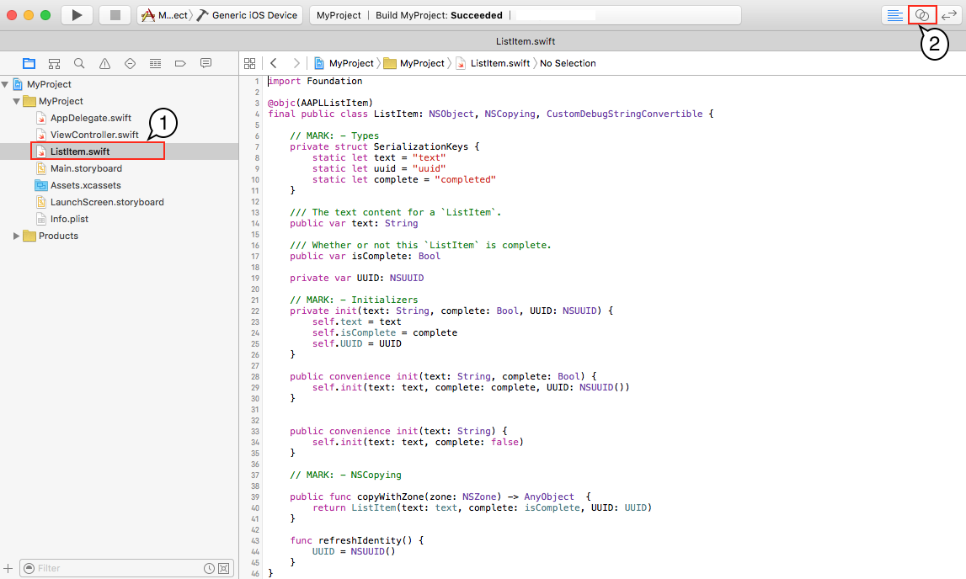
3. Environment development
Swift
- An object-oriented and compiled programing language
- First introduced on June 2, 2014, will relace Objective-C
- Now version 5.3 – 16/9/2020

Slide 15
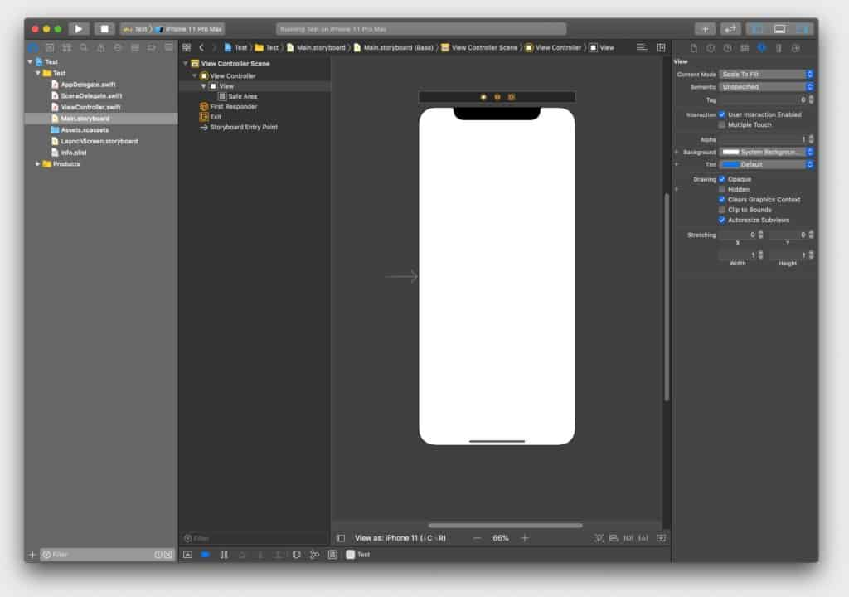
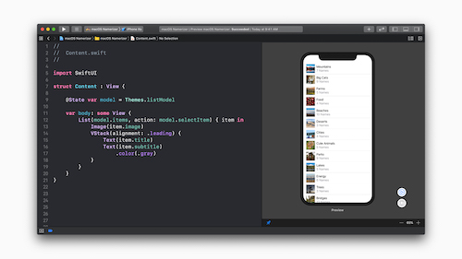
3. Environment development
UIKit vs Storyboard | SwiftUI
- UIKit is a imperative framework - provide the required infrastructure for your iOS apps - A storyboard is a visual representation of the user interface of an iOS application, showing screens of content and the connections between those screens - First introduced iOS 5 | - a declarative framework - a modern way to declare user interfaces for any Apple platform. Create beautiful, dynamic apps faster than ever before - support only iOS 13 and Xcode 11 - Introduced in WWDC 2019

Slide 16
DEMO

Slide 17


